Slide 1

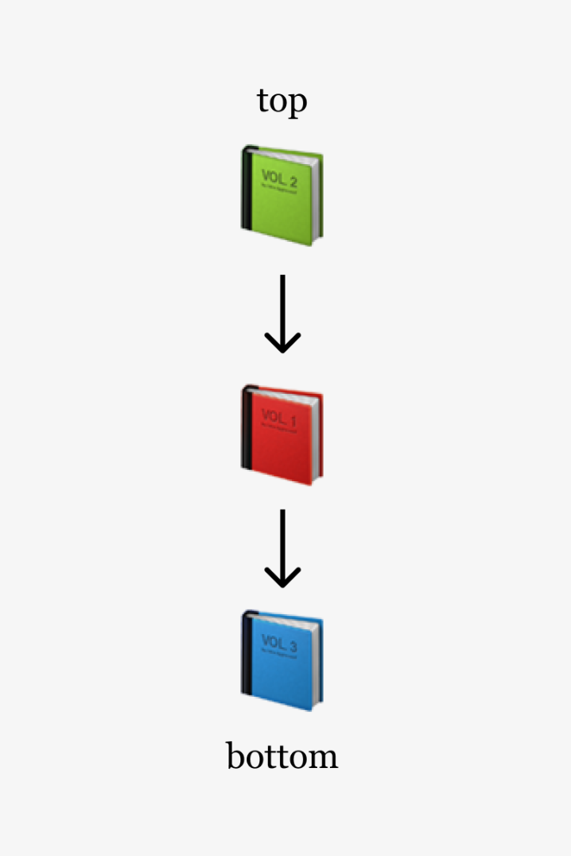
Stack Based Text Editor using Data Structures
Welcome to a journey into the world of stack-based text editors! In this presentation, we'll explore the concept, advantages, implementation, and unique features of this innovative approach.
Team Members:
Mohan Nagal - RA2211003011960
Ashwin - RA2211003012009
Aarav Mehta - RA2211003011966

Slide 2

Background of Stack Data Structure
1
Foundational Concept
Discover the fundamentals of stack data structure and its significance in computer science.
2
Stack Operations
Explore the push and pop operations that enable the efficient management of data in the stack.
3
Real-World Analogies
Uncover relatable examples to better understand the working principles of stacks.

Slide 3

Overview of Text Editors
1
Evolution of Text Editors
Trace the history of text editors from their humble beginnings to their modern form.
Types of Text Editors
2
Explore the different categories of text editors, including terminal-based, graphical, and web-based.
3
Common Features
Learn about the essential functionalities that most text editors provide.

Slide 4
Advantages of a Stack Based Text Editor
Undo/Redo Operations
Experience the power of seamless undo/redo functionality, enabling you to effortlessly reverse and redo changes.
Efficient Memory Management
Discover how stack-based editors optimize memory utilization for improved performance and resource allocation.
Easy to Implement
Appreciate the simplicity and elegance of developing a stack-based text editor, making it accessible to aspiring programmers.

Slide 5
Implementation of a Stack Based Text Editor
The main objective of this program is to provide a simple text editing tool that allows
users to manipulate and manage a text document, enabling actions like editing,
saving, and loading text content. It is designed to offer basic text editing
functionalities to users in a menu-driven manner, and the user can choose from a set
of options to interact with the text document. The program ensures the ability to track
and revert changes (undo and redo), save the document to a file, and load text from a
file. Additionally, it provides a search feature to find specific text within the
document. The program runs in an interactive loop until the user decides to exit.
this text editor serves as a foundation for more advanced text editing features and can
be used as a starting point for building more sophisticated text editing applications.

Slide 6
What’s New?
File I/O:
Enable users to save and load text documents. Implement import/export features for various file formats (e.g., plain text, Markdown, HTML).
Search and Replace:
Allow users to search for specific text and replace it with another string. Implement search options such as case sensitivity and regular expressions.

Slide 7

Features and Functionalities of the Text Editor
1
Intuitive User Interface
Experience a user-friendly interface designed to enhance productivity and ease of use.
2
Syntax Highlighting
See your code come to life with syntax highlighting, allowing for better readability and error detection.
3
Auto-Save
Never lose your work again with an automatic saving feature that ensures peace of mind.

Slide 8
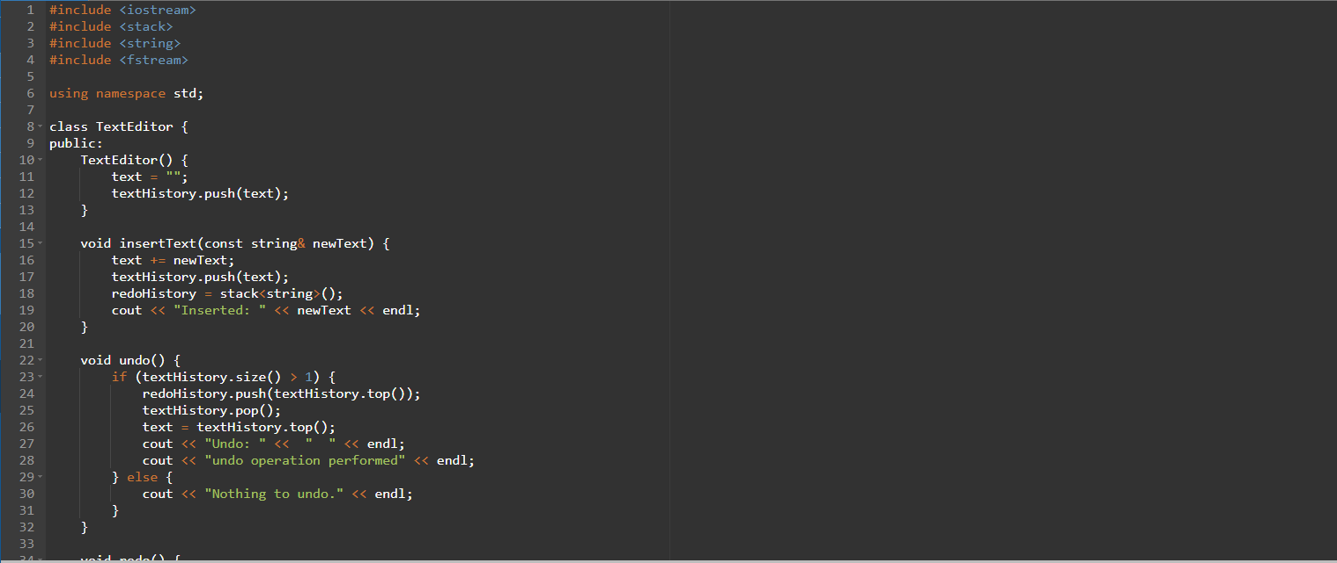

Slide 9
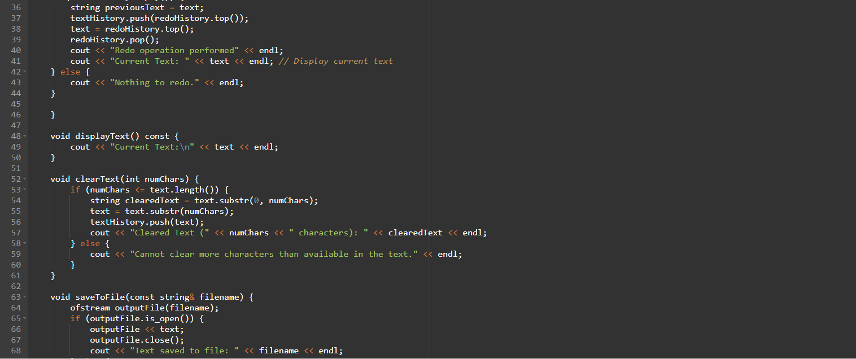

Slide 10
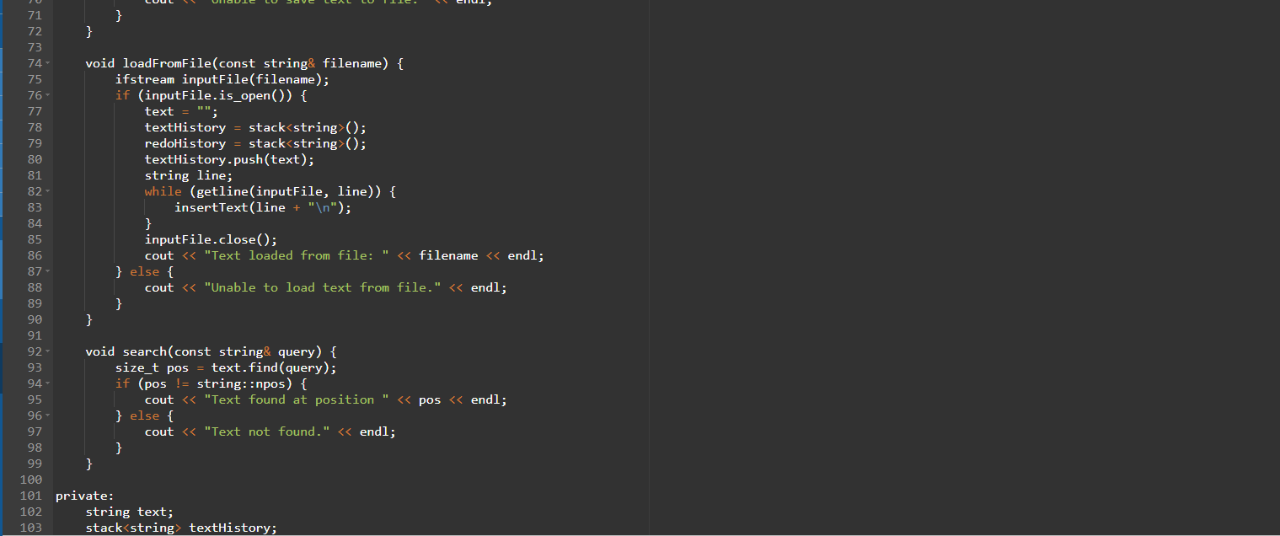

Slide 11
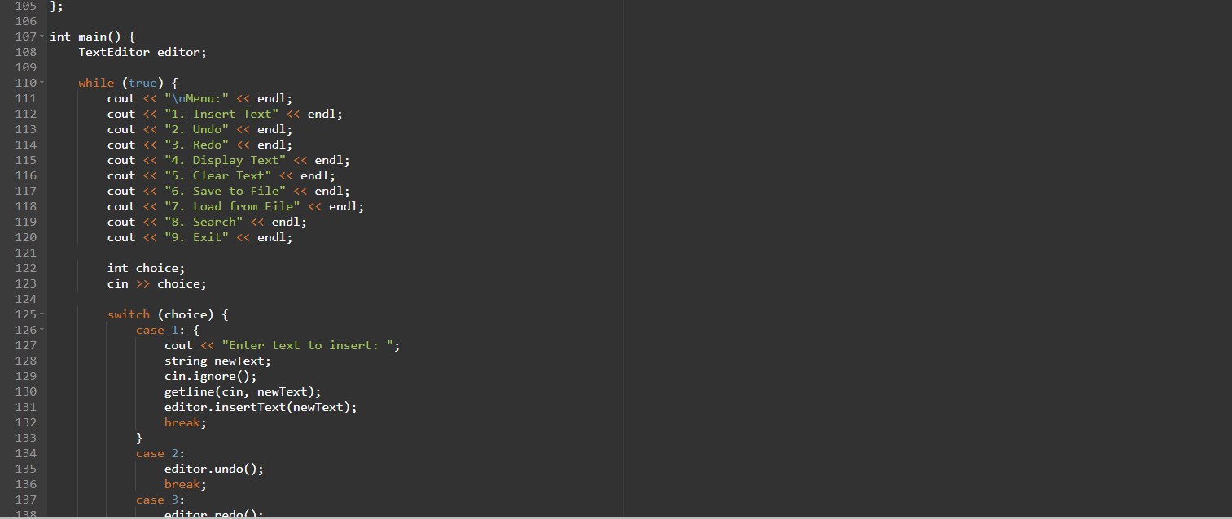

Slide 12
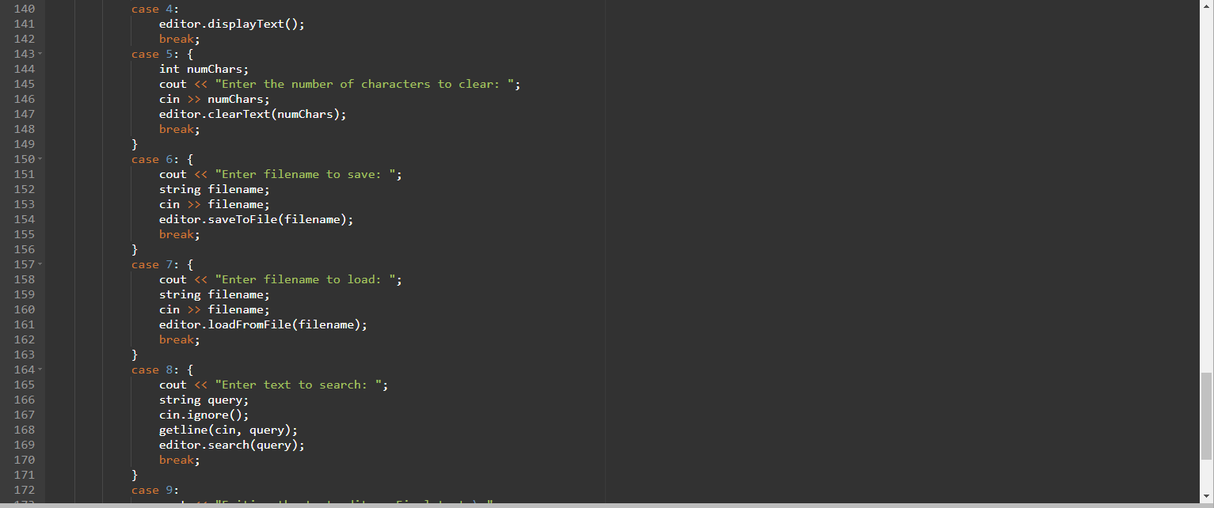

Slide 13
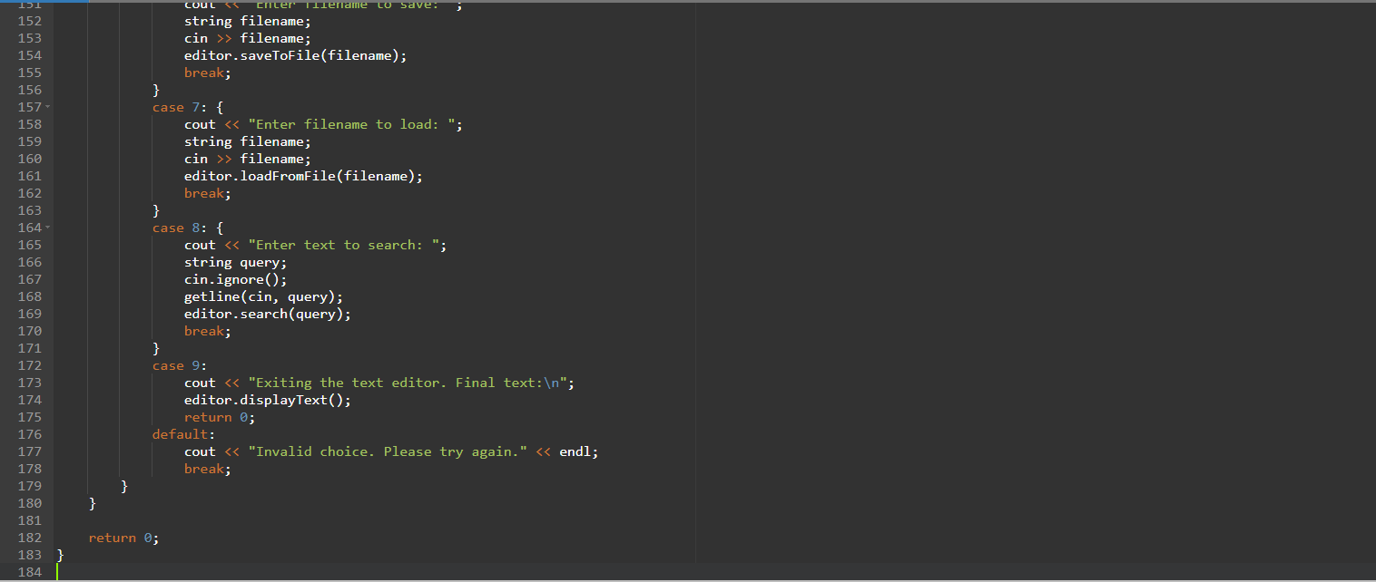

Slide 14
Conclusion
As we conclude this presentation, we hope you have gained valuable insights into the stack-based text editor and its potential impact on the future of coding. Embrace the versatility and efficiency of this innovative approach in your programming journey!

